Slide 1
DIGI-AAMIAINEN
“Cost effective technology tools for business”
Darren Trofimczuk
Darren.trofimczuk@haaga-helia.fi
www.dtrofimczuk.co.uk

Slide 2
Lecture Content
“Cost effective technology tools for business”
Business website design & key functions
Website SEO & Analytic tools
Cloud based calloboration tools
App creation possibilities
Social Media

Slide 3
Something about me
Originally from the UK
Most of my career has been in education technology over the last 14yrs
Moved to Finland in 2011
Started a business in Finland in 2013-www.troftech.com
Started as a Lecturer in Information Technology at Haaga-Helia in August 2015. Courses-ICT in Business, Virtual course in e-Business and the development of e-Learning
Darren Trofimczuk,
Lecturer Information Technology
International Business and Tourism Programmes
FI-006150 Porvoo
+358 (0)40 488 7215
darren.trofimczuk@haaga-helia.fi
www.haaga-helia.fi
www.dtrofimczuk.co.uk

Slide 4
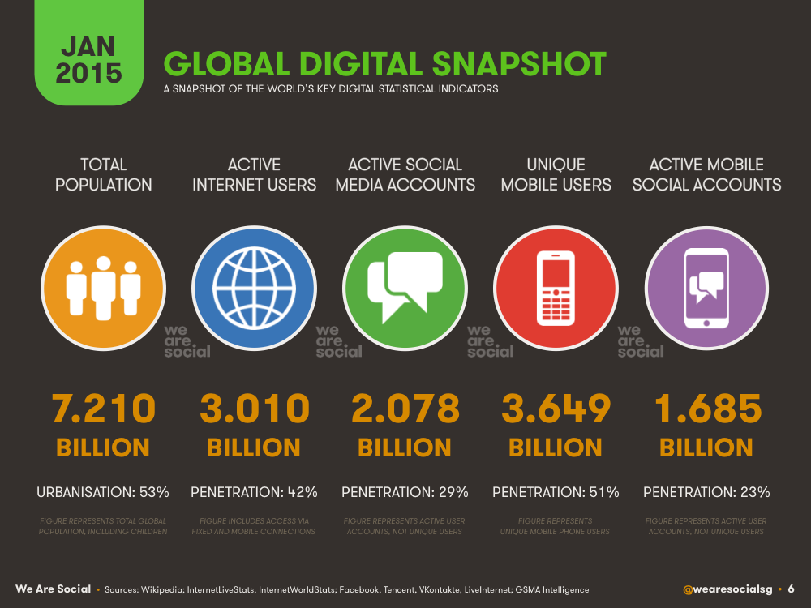
And finally….

Slide 5
Finland is making positive steps!!
Finnish e-commerce imports now heavily outnumber exports!!
Government has pledged to allocate funds to boost e-commerce initiatives
Team Finland programme to foster e-commerce growth.
http://yle.fi/uutiset/finnish_retailers_up_their_online_game_with_state_investment/8800538

Slide 6
Business website design & key functions
There are many website design companies that offer business website creation services for a set cost, but there are now many effective cheap online platforms that can be used to build a fully working business website. My favourite website creation platform is Weebly
www.weebly.com

Slide 7
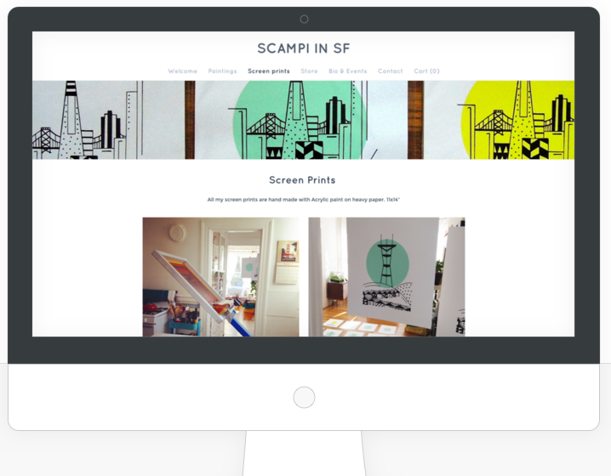
Content control
eCommerce features
Business Hosting and Templates
Multimedia display tools
Online drag & drop tools
SEO & Analytic tools
Mobile phone friendly website builder
Advanced HTML coding tool

Slide 8
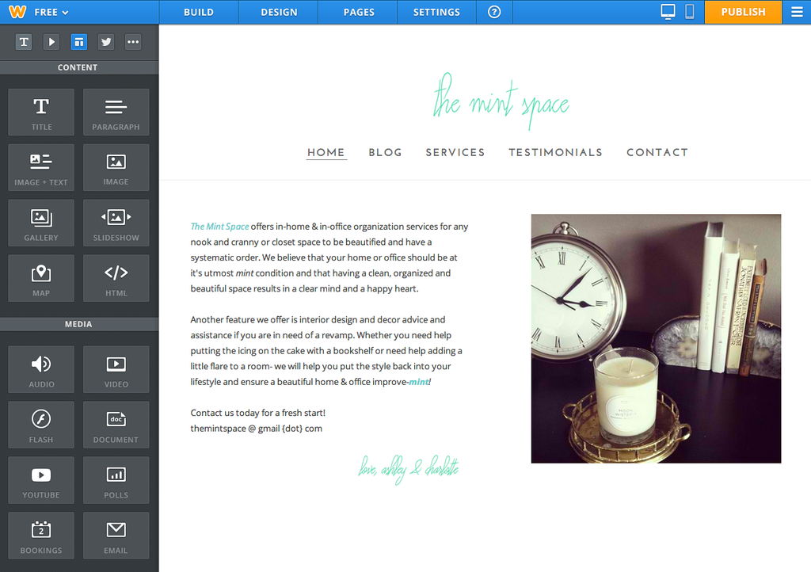
TOBBA 15 Personal Website Examples

Slide 9
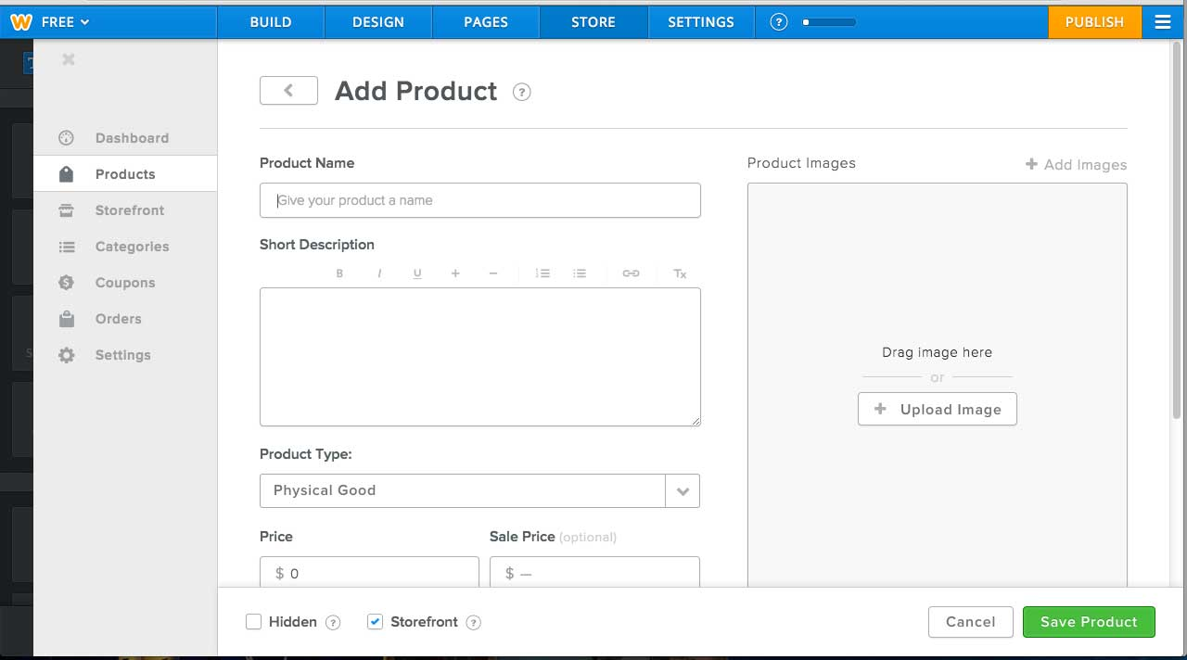
Weebly e-Commerce
SSL checkout on your domain
shipping and tax management
coupon and discount codes
Order management

Slide 10
Business website design
Other cost effective solution similar to Weebly?
https://wordpress.com/
http://www.wix.com/

Slide 11
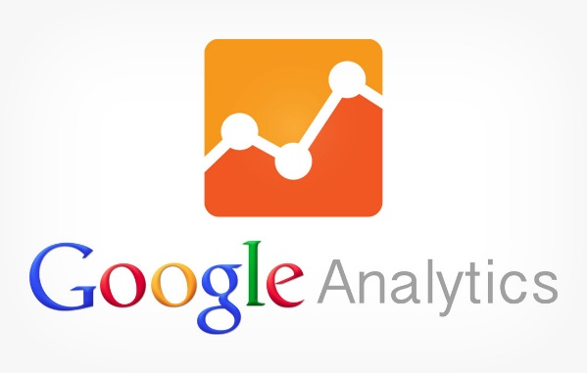
Google Analytics
Website SEO & Analytic tools
Google analytic service that allows you to monitor website traffic.
http://www.google.com/analytics/
Tracking codes placed on website pages
Dashboard system for monitoring website traffic

Slide 12
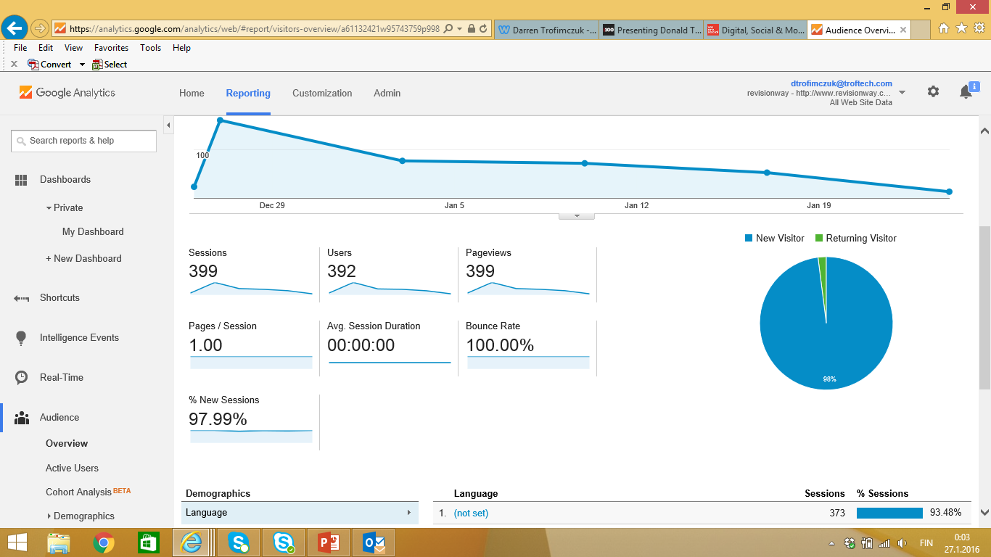
Google Analytics

Slide 13
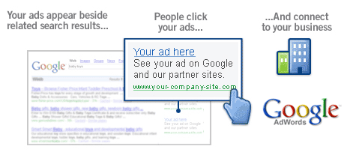
Google Adwords
Pay per click advertising using keywords
http://www.google.com/adwords/

Slide 14
SEO (Search Engine Optimization)
The best way to think of SEO is how well your webiste is structured, so it can be found quicker by different search engines.
Page name and title descriptions
Website loading time (big pictures, lots of media can slow things down)
Register your website with Google, Bing
Errors on webpage (internal and external links,

Slide 15
Website SEO & Analytic tools
https://moz.com/
SEO Reports
SEO Optimization tips/suggestions
Analytics tracker

Slide 16
Cloud based calloboration tools

Slide 17
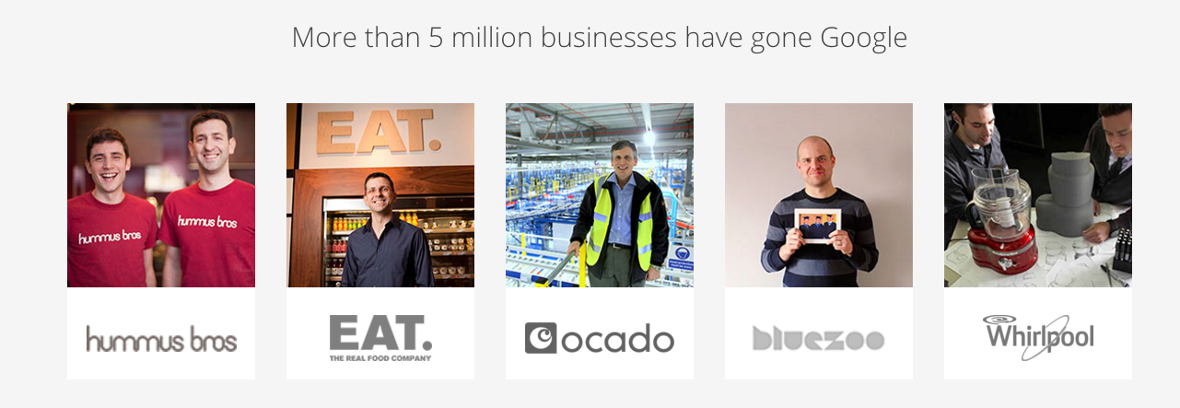
Cloud based calloboration tools

Slide 18
Cloud based calloboration tools
Google Drive-Useful tools for business:
Unlimited storage options (5 users get 1TB each)
Email & Calendar
Google Hangouts (Video conferencing)
Alternative software solutions for-Microsoft Office, spreadsheets, images, PDF
Business templates & Solutions-open source community
Form & survey creator
https://apps.google.com/intx/en_ie/products/drive/

Slide 19
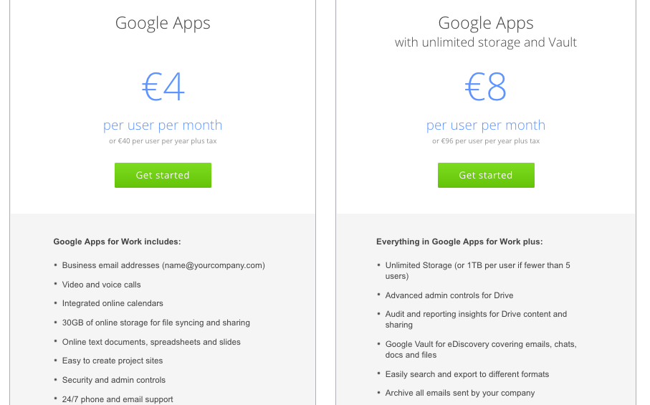
Cloud based calloboration tools
https://apps.google.com/intx/en_ie/products/drive/

Slide 20
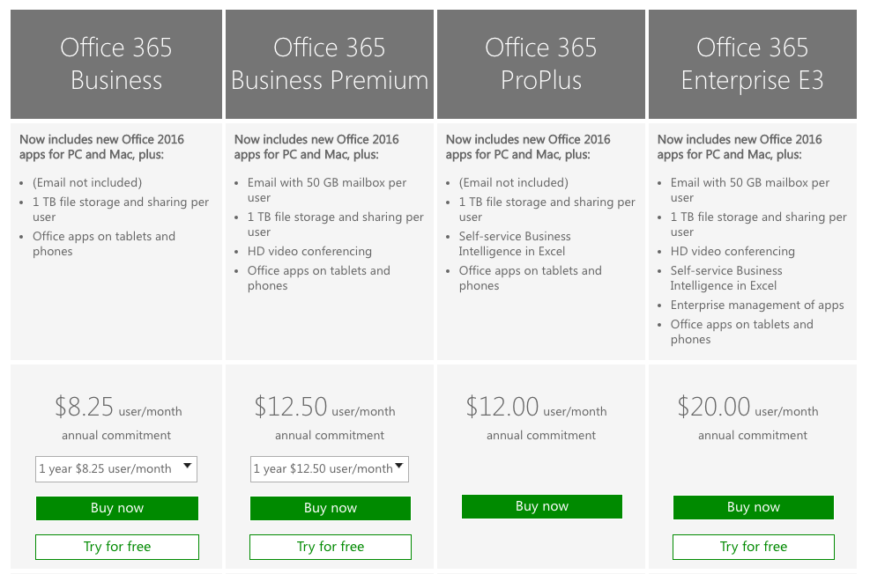
Cloud based calloboration tools-other options

Slide 21
App creation possibilities
Como DIY –”Big solution for small business”
Mobile Store
Product Catalogs
Loyalty cards & customer reward tools
Push notifications
Como Premium -ideal for midsize merchants, chains, and brands. A Como account manager will work with you to develop your custom loyalty program and branded mobile app.
http://www.como.com/

Slide 22
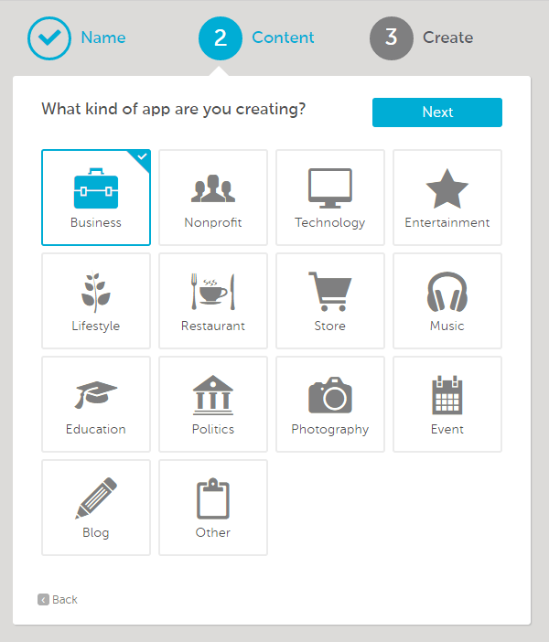
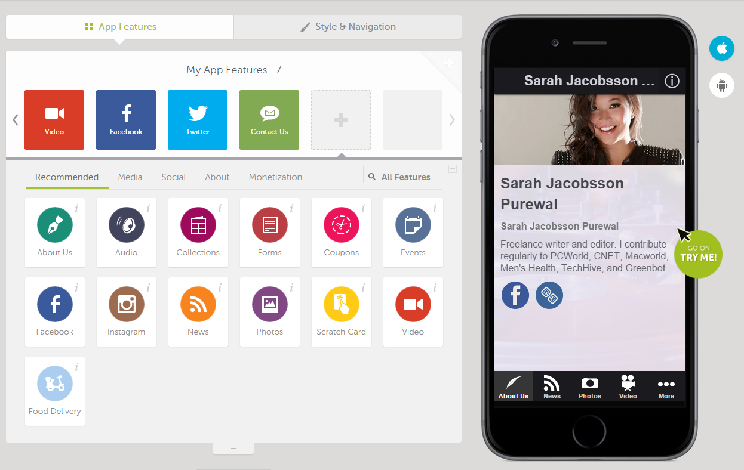

Slide 23
Social Media
Business Facebook page & some marketing
Company profile page & use for recruitment
Marketing & Event promotion
Instagram: Marketing

Slide 24
Summary
Business Website:
Website SEO & Analytic tools:
Cloud based calloboration tools:
App creation:
Social Media:

Slide 25
References
https://www.google.com/analytics/
https://www.google.com/adwords/
www.weebly.com
www.facebook.com
www.como.com
www.moz.com
https://apps.google.com/intx/en_ie/products/drive/
https://www.linkedin.com/
http://yle.fi/uutiset/finnish_retailers_up_their_online_game_with_state_investment/8800538

